Slide 1
Hyperparameter Optimization
Aiden Tepper
Informatics Skunkworks (MSE 299), 2 Credits
04-25-2021

Slide 2
Hours Summary
Date | Hours | Description of Work
4/20 | 3.5 | Google NN playground, first half of colab work
4/21 | 2 | Second half of colab work
4/23 | 1 | Working out issues with the colab code
4/25 | 1 | Finishing up and creating slide deck

Slide 3
Progress
The task assigned to us this week was to work through the “Hyperparameter Optimization” module
I first worked through the activities on Google’s neural network playground website, finishing up with the first assessment figure. Then, I worked through the provided colab notebook, which walked us through cleaning the bandgap data once more then creating, testing, and optimizing a neural network model for the data
The best way to represent results from this week’s tasks is through either the output from running the Colab code or through screenshots from the activities on Google’s neural network playground page

Slide 4
Problems
I didn’t encounter any major issues while working with Google neural network playground, aside from some gaps in my knowledge that I was able to figure out by watching all the linked videos and tutorials
I encountered an issue towards the end of the Colab notebook where I couldn’t get a certain line of code to run, but I was able to figure that out after reading through the documentation and realizing that I was giving the function the wrong inputs
I also had some slight confusion with what was going on behind the hood when optimizing the neural network model towards the end of the Colab notebook

Slide 5
Questions
I don’t have any major questions from this week’s work, aside from wanting to learn more in depth about how neural networks work and why changing certain hyperparameters can result in different outcomes, often varying dramatically when running the same simulation multiple times

Slide 6
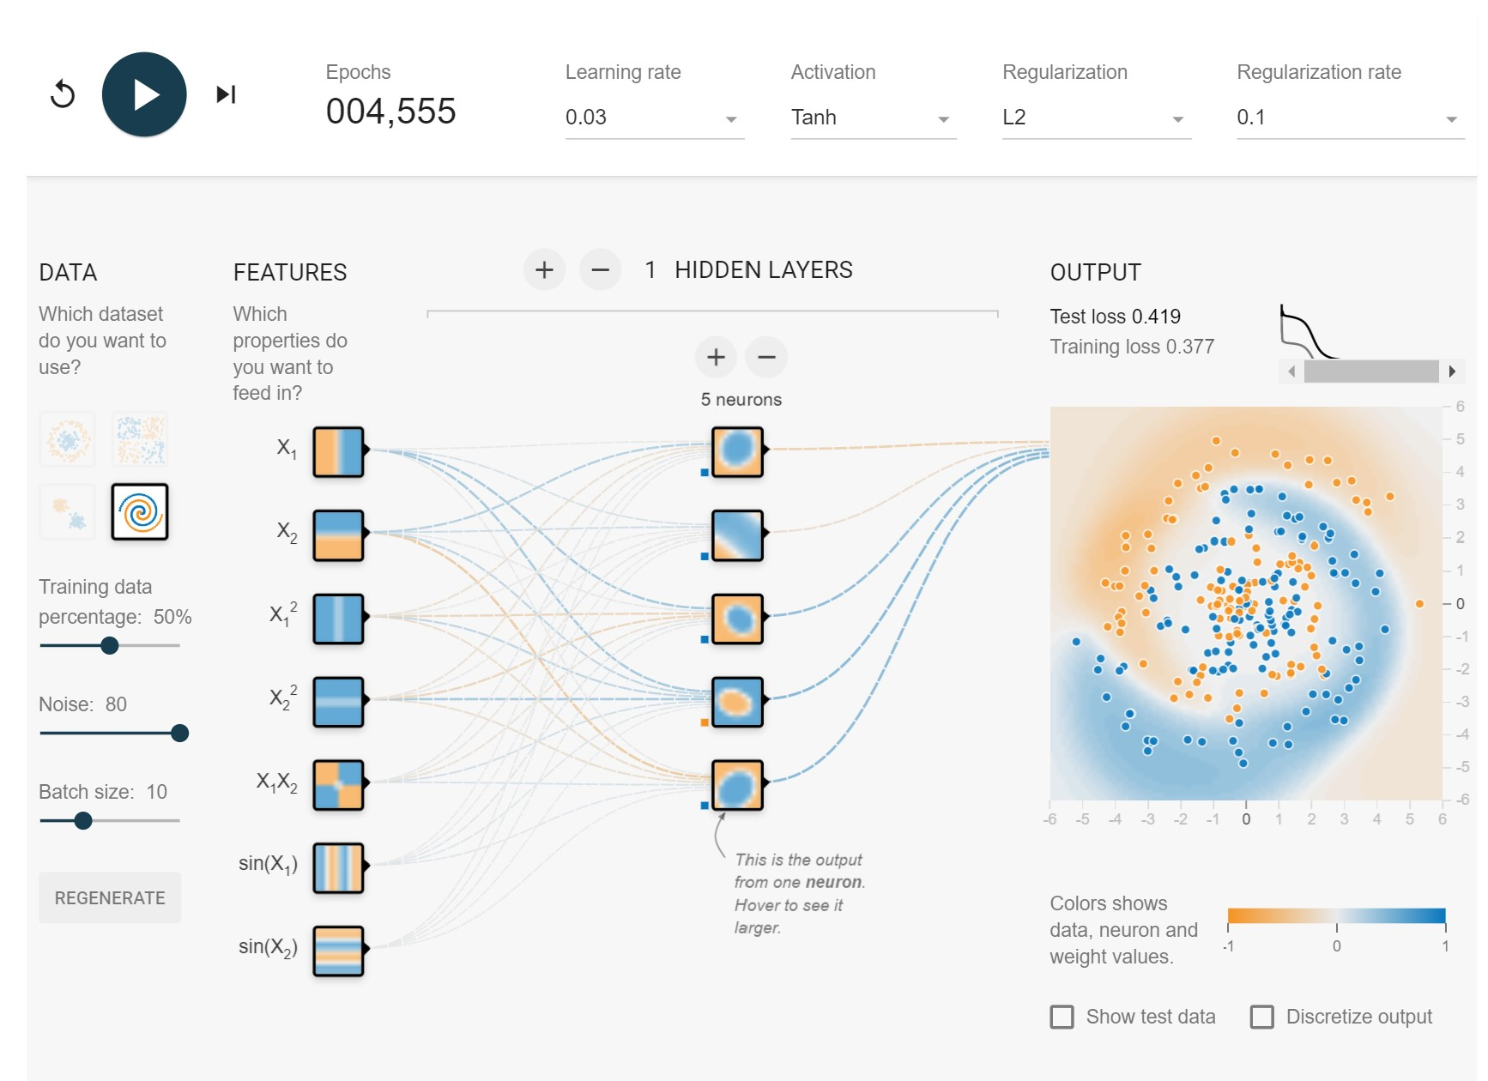
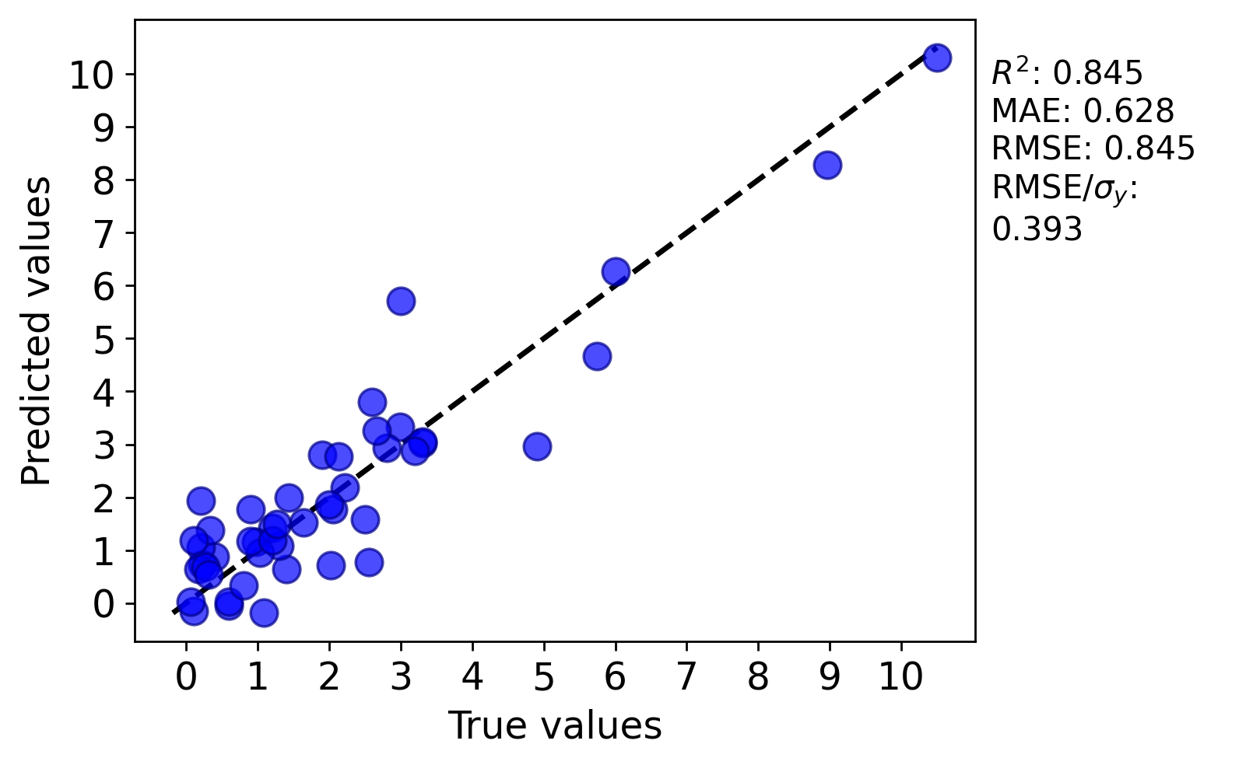
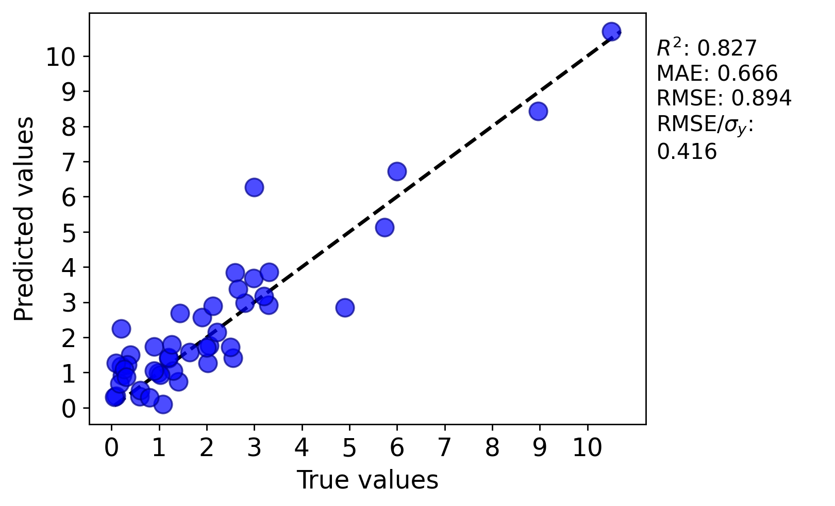
Assessment Figures

